Slide 1
Cryptography as a security tool
Lecture Five

Slide 2
Lecture five outline
Applications and uses of cryptography
Encryption methodologies
Cryptanalysis
Management of cryptography
Key management

Slide 3
Applications and Uses of Cryptography
What Is Cryptography
Cryptography is the science of hiding information in plain sight, in order to conceal it from unauthorized parties.
is the practice and study of techniques for secure communication in the presence of third parties (called adversaries).
More generally, it is about constructing and analyzing protocols that overcome the influence of adversaries and which are related to various aspects in information security such as data confidentiality, data integrity, authentication, and non-repudiation.
Applications of cryptography include ATM cards, computer passwords, and electronic commerce.

Slide 4
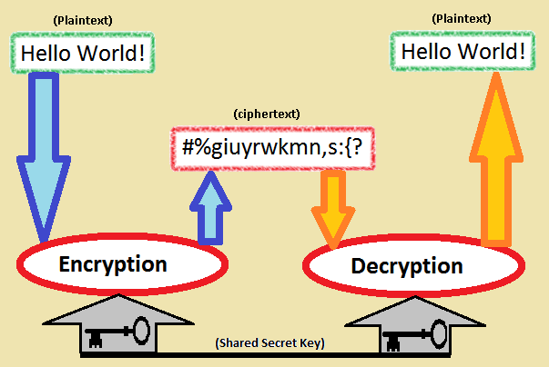

Cryptography….

Slide 5
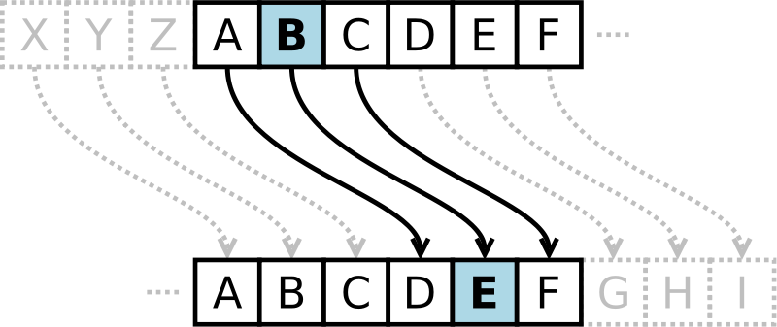
Cryptography…
Substitution cipher first used by Caesar for battlefield communications

Slide 6
Encryption Terms and Operations
Plaintext – an original message
Ciphertext – an encrypted message
Encryption – the process of transforming plaintext into ciphertext (also encipher)
Decryption – the process of transforming ciphertext into plaintext (also decipher)
Encryption key – the text value required to encrypt and decrypt data

Slide 7
Encryption methodologies
Substitution Cipher
Plaintext characters are substituted to form ciphertext
  “A” becomes “R”, “B” becomes “G”, etc.
  Character rotation
    Caesar rotated three to the right (A > D,
    B > E, C > F, etc.)
  A table or formula is used
  ROT13 is a Caesar cipher

Slide 8
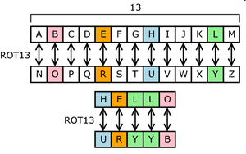
Encryption methodologies…….
Substitution Cipher……
Subject to frequency analysis attack

Slide 9
Encryption methodologies…….
frequency analysis
In cryptanalysis, frequency analysis is the study of the frequency of letters or groups of letters in a ciphertext. The method is used as an aid to breaking classical ciphers.
Frequency analysis is based on the fact that, in any given stretch of written language, certain letters and combinations of letters occur with varying frequencies. Moreover, there is a characteristic distribution of letters that is roughly the same for almost all samples of that language.
Eg. given a section of English language, E, T, A and O are the most common, while Z, Q and X are rare. Likewise, TH, ER, ON, and AN are the most common pairs of letters (termed bigrams or digraphs), and SS, EE, TT, and FF are the most common repeats.
The nonsense phrase "ETAOIN SHRDLU" represents the 12 most frequent letters in typical English language text.

Slide 10
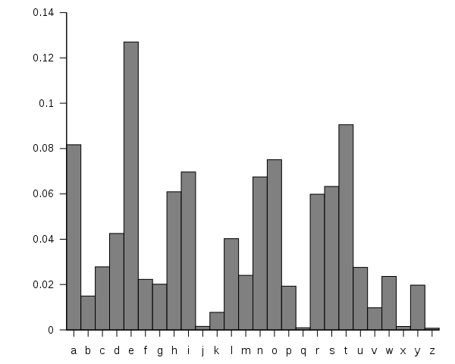
English letter frequency

Slide 11
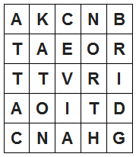
Encryption methodologies…….
2. Transposition Cipher
Plaintext messages are transposed into ciphertext
Plaintext: ATTACK AT ONCE VIA NORTH BRIDGE
  Write into columns going down
  Read from columns to the right
Ciphertext:
AKCNBTAEORTTVRIAOITDCNAHG
Subject to frequency analysis attack

Slide 12
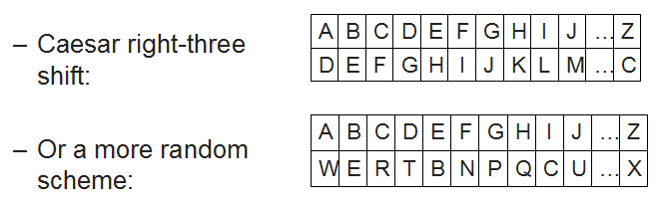
Encryption methodologies…….
3. Monoalphabetic Cipher
One alphabetic character is substituted or another
Subject to frequency analysis attack

Slide 13
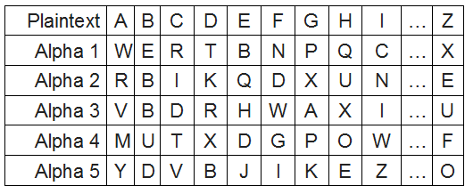
Encryption methodologies…….
4. Polyalphabetic Cipher
Two or more substitution alphabets
CAGED becomes RRADB
Not subject to frequency attack

Slide 14
Encryption methodologies…….
5. Running-key Cipher
Plaintext letters converted to numeric (A=0, B=1, etc.)
Plaintext values “added” to key values giving ciphertext
Modulo arithmetic is used to keep results in range 0-26
  Add 26 if results < 0; subtract 26 if results > 26

Slide 15
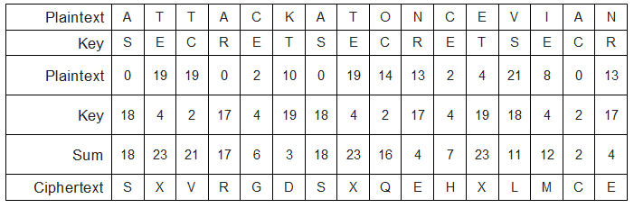
Encryption methodologies…….
5. Running-key Cipher…….

Slide 16
Encryption methodologies…….
6. One-time Pad
Works like running key cipher, except that key is length of plaintext, and is used only once
Highly resistant to cryptanalysis
  Cryptanalysis is used to breach cryptographic security systems and gain access to the contents of encrypted messages, even if the cryptographic key is unknown.

Slide 17
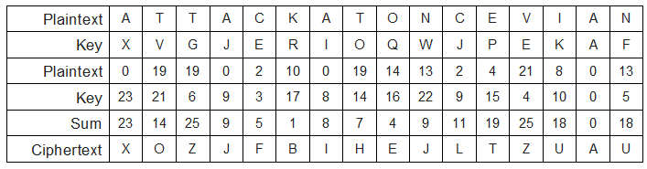
Encryption methodologies…….
6. One-time Pad….

Slide 18
Types of Encryption
1. Block cipher
Encrypts blocks of data, often 128 bits
A block cipher is a deterministic algorithm operating on fixed-length groups of bits, called blocks, with an unvarying transformation that is specified by a symmetric key.
  Symmetric-key algorithms are a class of algorithms for cryptography that use the same cryptographic keys for both encryption of plaintext and decryption of ciphertext
Block ciphers are important elementary components in the design of many cryptographic protocols, and are widely used to implement encryption of bulk data.

Slide 19
Types of Encryption…
2. Stream cipher
Operates on a continuous stream of data
A stream cipher is a symmetric key cipher where plaintext digits are combined with a pseudorandom cipher digit stream (keystream).
In a stream cipher each plaintext digit is encrypted one at a time with the corresponding digit of the keystream, to give a digit of the cyphertext stream. An alternative name is a state cipher, as the encryption of each digit is dependent on the current state.
In practice, a digit is typically a bit and the combining operation an exclusive-or (xor).
  Each bit position returns a one if either bits of the operands are ones but not both
The pseudorandom keystream is typically generated serially from a random seed value using digital shift registers

Slide 20
Types of Encryption…
Stream Ciphers
Used to encrypt a continuous stream of data, such as an audio or video transmission
A stream cipher is a substitution cipher that typically uses an exclusive-or (XOR) operation that can be performed very quickly by a computer.
Most common stream cipher is RC4
Other stream ciphers
A5/1, FISH, Phelix1, ISAAC, MUGI, Panama, Phelix, Pike, Sapphire-II. SEAL, SOBER-128, and WAKE

Slide 21
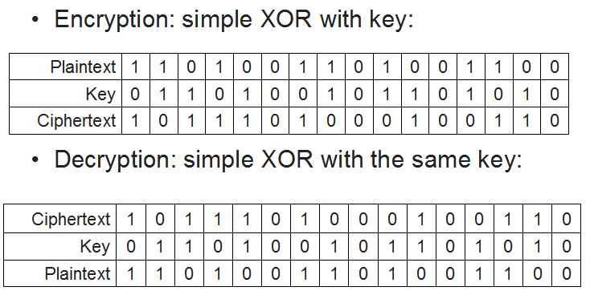
Types of Encryption…
Stream Ciphers….

Slide 22
Types of Encryption…
Block Ciphers
Encrypt and decrypt a block of data at a time
  Typically 128 bits
Typical uses for block ciphers
  Files, e-mail messages, text communications, web
Well known encryption algorithms
  DES, 3DES, AES, CAST, Twofish, Blowfish, Serpent

Slide 23
Types of Encryption…
Block Cipher Modes of Operation
modes of operation is the procedure of enabling the repeated and secure use of a block cipher under a single key
  Electronic Code Book (ECB)
  Cipher-block chaining (CBC)
  Cipher feedback (CFB)
  Output feedback (OFB)
  Counter (CTR)
Initialization Vector (IV)
Starting block of information needed to encrypt the first block of data
IV must be random and should not be re-used
  WEP wireless encryption is weak because it re-uses the IV, in addition to making other errors

Slide 24
Types of Encryption…
Block Cipher: Electronic Code Book
Simplest block cipher mode
Each block encrypted separately
  Like plaintext encrypts to like ciphertext
  Vulnerable to a dictionary attack
  WEP does this
  Microsoft made this error in their password hashes
  Microsoft also made this error in Microsoft Office document encryption

Slide 25
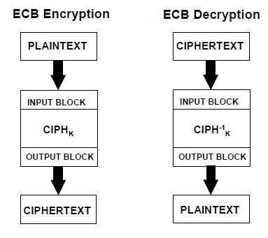
Types of Encryption…
Block Cipher: Electronic Code Book…

Slide 26
Types of Encryption…
Block Cipher: Cipher-block Chaining (CBC)
Ciphertext output from each encrypted plaintext block is used in the encryption for the next block
First block encrypted with IV (initialization vector)

Slide 27
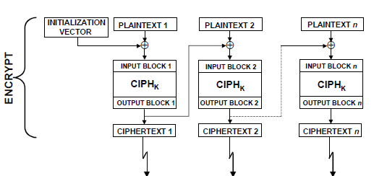
Types of Encryption…

Slide 28
Types of Encryption…
Block Cipher: Cipher Feedback (CFB)
Plaintext for block N is XOR’d with the ciphertext from block N-1.
In the first block, the plaintext XOR’d with the encrypted IV

Slide 29
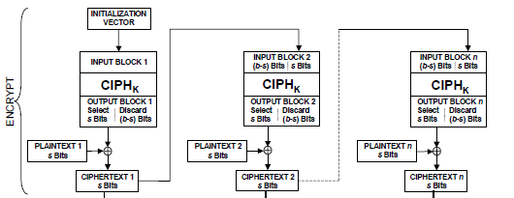
Types of Encryption…
Block Cipher: Cipher Feedback (CFB)

Slide 30
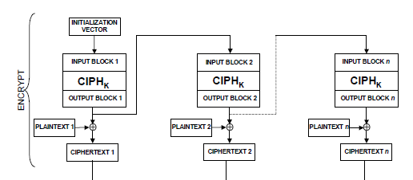
Types of Encryption…
Block Cipher: Output Feedback (OFB)
Plaintext is XOR’d with the encrypted material in the previous block to produce ciphertext

Slide 31
Types of Encryption…
Block Cipher: Counter (CTR)
Uses a “nonce” (a random number that is used once) that is concatenated with a counter or other simple function, to create a series of keys
      a counter is a device which stores (and sometimes displays) the number of times a particular event or process has occurred, often in relationship to a clock signal.
        a clock signal is a particular type of signal that oscillates between a high and a low state
Allows parallel computation

Slide 32
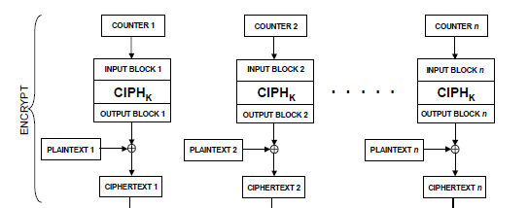
Types of Encryption…
Block Cipher: Counter (CTR)…

Slide 33
Types of Encryption Keys
Symmetric key
A common secret that all parties must know
Difficult to distribute key securely
Used by DES, 3DES, AES, Twofish, Blowfish, IDEA, RC5

Slide 34
Types of Encryption Keys..
2. Asymmetric key
Public / private key
Openly distribute public key to all parties
Keep private key secret
Anyone can use your public key to send you a message
Used by RSA. El Gamal, Elliptic Curve

Slide 35
Types of Encryption Keys..
Asymmetric Encryption Uses
Encrypt message with recipient's public key
  Only recipient can read it, using his or her private key
  Provides confidentiality
Sign message
  Hash message, encrypt hash/ jumble with your private key
  Anyone can verify the signature using your public key
  Provides integrity and non-repudiation (sender cannot deny authorship)
Sign and encrypt
  Both of the above

Slide 36
Diffie-Hellman Key Exchange
is a specific method of exchanging cryptographic keys.
It is one of the earliest practical examples of key exchange implemented within the field of cryptography.
The Diffie–Hellman key exchange method allows two parties that have no prior knowledge of each other to jointly establish a shared secret key over an insecure communications channel.
This key can then be used to encrypt subsequent communications using a symmetric key cipher.
The scheme was first published by Whitfield Diffie and Martin Hellman in 1976,

Slide 37
Length of Encryption Keys
For symmetric algorithms, use at least 128 bits
For RSA(Ron Rivest, Adi Shamir and Leonard Adleman ), use at least 2048 bits
    RSA is an algorithm for public-key cryptography that is based on the presumed difficulty of factoring large integers, the factoring problem
1024 bits no longer recommended by NIST (National Institute of Standards and Technology )

Slide 38
Protection of Encryption Keys
Symmetric keys
  Must be restricted to as few people as possible
  Protected by a strong password, or encrypted again if needed
Asymmetric keys
  Private key requires protection similar to symmetric key
  Public keys can be published, even on the Internet

Slide 39
Protecting Keys in Applications
More difficult to protect keys that applications must be able to access directly
Hardening techniques
  Separation of duties
    Key value known only to operators, not developers or support
  Store keys in hardware
    Such as Trusted Platform Module
      Trusted Platform Module (TPM) is both the name of a published specification detailing a secure cryptoprocessor that can store cryptographic keys that protect information, and the general name of implementations of that specification, often called the "TPM chip" or "TPM Security Device".
  Use of a key encrypting key

Slide 40
Cryptanalysis
Cryptanalysis (from the Greek kryptós, "hidden", and analýein, "to loosen" or "to untie")
Is the art and science of analyzing information systems in order to study the hidden aspects of the systems.
Cryptanalysis is used to breach cryptographic security systems and gain access to the contents of encrypted messages, even if the cryptographic key is unknown.

Slide 41
Cryptanalysis…
1. Frequency analysis
  Analyzing frequency of characters in ciphertext
2. Birthday attacks
Exploits the mathematics behind the birthday problem in probability theory. This attack can be used to abuse communication between two or more parties.
The attack depends on the higher likelihood of collisions found between random attack attempts and a fixed degree of permutations (pigeonholes), as described in the birthday problem/paradox.
    Collisions in a hash function can be found in approximately sqrt(N) attempts, where N is the number of possible hash values
    So SHA-1, 160 bits long, will have a collision in 2^80 values

Slide 42
Cryptanalysis
2. Birthday attacks….
As an example,
consider the scenario in which a teacher with a class of 30 students asks for everybody's birthday, to determine whether any two students have the same birthday (corresponding to a hash collision as described below;
For simplicity, ignore February 29).
Intuitively, this chance may seem small. If the teacher picked a specific day (say September 16), then the chance that at least one student was born on that specific day is , about 7.9%.
However, the probability that at least one student has the same birthday as any other student is around 70% (using the formula for n = 30

Slide 43
Cryptanalysis…
3. Ciphertext only attack
  Attacker has only ciphertext
4. Chosen plaintext attack
  Attacker is able to see encryption of selected plaintext
5. Chosen ciphertext attack
  Cryptanalyst gathers information, at least in part, by choosing a ciphertext and obtaining its decryption under an unknown key.
  In the attack, an adversary has a chance to enter one or more known ciphertexts into the system and obtain the resulting plaintexts.
  From these pieces of information the adversary can attempt to recover the hidden secret key used for decryption.

Slide 44
Cryptanalysis..
6. Known plaintext attack
  where the attacker has samples of both the plaintext (called a crib), and its encrypted version (ciphertext).
  These can be used to reveal further secret information such as secret keys and code books.
    The term "crib" originated at Bletchley Park, the British World War II decryption operation

Slide 45
Cryptanalysis..
7. Man in the middle attack
Is a form of active eavesdropping in which the attacker makes independent connections with the victims and relays/ sends messages between them, making them believe that they are talking directly to each other over a private connection, when in fact the entire conversation is controlled by the attacker.
The attacker must be able to intercept all messages going between the two victims and inject new ones, which is straightforward in many circumstances
for example, an attacker within reception range of an unencrypted Wi-Fi wireless access point, can insert himself as a man-in-the-middle
  Effective against Diffie-Hellman Key Exchange
  Real public key is replaced by fake one

Slide 46
Cryptanalysis..
8. Replay attack
  A form of network attack in which a valid data transmission is maliciously or fraudulently repeated or delayed.
  This is carried out either by the originator or by an adversary /enemy who intercepts the data and retransmits it, possibly as part of a masquerade attack by IP packet substitution (such as stream cipher attack)
    Effective against SMB, any non-secure cookie-based authentication, almost all Web 2.0 sites

Slide 47
Applications and Management of Cryptography
Uses for Cryptography
1. File encryption
  PGP and GPG
  WinZip (version 9 uses AES)
  EFS (encrypting file system) for Windows
  Crypt tool for Unix

Slide 48
Uses for Cryptography…
2. Encrypted volumes and disks
  Truecrypt for Windows, Mac, Unix
  Bitlocker for Windows Vista
  PGP Disk
  SafeBoot

Slide 49
Uses for Cryptography…
3. E-mail
  PGP / GPG – asymmetric key (public key crypto)
  S/MIME (Secure / Multipurpose Internet Mail Extensions) – certificate based
  PEM (Privacy Enhanced Mail) – not widely used, requires a single global PKI (which was never implemented)
  MOSS (MIME Object Security Services) – not widely used

Slide 50
Uses for Cryptography…
4. Protecting network communications
  SSH
    Replacement for telnet, rsh, rlogin
        rlogin is a software utility for Unix-like computer operating systems that allows users to log in on another host via a network, communicating via TCP port 513
    Secure FTP
  IPsec (Internet Protocol Security )
    Encrypts all packets between established pairs of hosts
    Used for VPNs (Virtual Private Networks)
  SSL/TLS
    Protects web browser traffic

Slide 51
Uses for Cryptography…
5. Web browsing –
protects session contents from eavesdropping
  SSL / TLS (Secure Sockets Layer / Transport Layer Security)
    https: in URL
    40-512 bit encryption with secure key exchange
    Server authentication common, client authentication rare
  SET (Secure Electronic Transaction)
    Not widely used

Slide 52
Key Management
Key creation
  Process and results must be protected
Key protection and custody
  Secured keys in control by the fewest number of persons
Key rotation
  Periodic update of encryption keys
Key destruction
  Securely destroy, to protect encrypted data to be retired
Key escrow
  Keys held by a trusted third party

Slide 53
Message Digests and Hashing
Message digest or hash
  The result of a one-way function on a file or message
  Fixed-length result regardless of message size
  Impossible (or very difficult) to derive original message from digest
  No other message should produce the same digest (such pairs are collisions)
  Algorithms
    MD-5, SHA-1, HMAC

Slide 54
Digital Signatures
A digital signature or digital signature scheme is a mathematical scheme for demonstrating the authenticity of a digital message or document.
A valid digital signature gives a recipient reason to believe that the message was created by a known sender such that they cannot deny sending it (authentication and non-repudiation)
and that the message was not altered in transit (integrity).
Digital signatures are commonly used for software distribution, financial transactions, and in other cases where it is important to detect forgery or tampering.

Slide 55
Digital Signatures….
Message digest that is cryptographically combined with signer’s private key
  Requires public key cryptography
  Verifies message integrity
  Verifies identity of signer
  Algorithms: DSA, El Gamal, Elliptic Curve DSA

Slide 56
Non-repudiation
Inability for a user to repudiate (deny) an action, because of the methods used to permit or authorize the action
  Digital signature
    Verifies integrity of transaction
    Verifies identity of person performing transaction
  Password required to use digital signature

Slide 57
Public Key Infrastructure (PKI)
Online facility
  Storage of users’ public encryption keys
  Fast lookup via an API that makes use automatic
      An application programming interface (API) is a protocol intended to be used as an interface by software components to communicate with each other
  PKI platforms
    LDAP
        The Lightweight Directory Access Protocol (LDAP) is an application protocol for accessing and maintaining distributed directory information services over an Internet Protocol (IP) network.
    Microsoft Active Directory

Slide 58
Encryption Alternatives
Steganography
  Data hidden in image files, subtle / faint changes that the eye won’t see; can be encrypted as well
  Many “stego” tools available
Watermarking
  Like a digital signature – a visible or invisible mark that claims ownership

Slide 59
END

